Slide 1
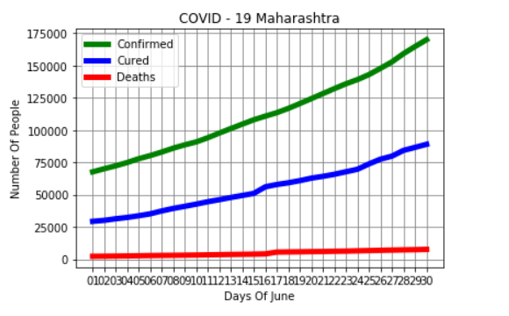


MINOR PROJECT
COVID – 19 MAHARASHTRA DATA
CONFIRMED
CURED
DEATHS

